Slide 1

Netflix Stock Capstone
Visualize Data with Python
Petru Apachitei
Date: 27-09-2020

Slide 2
Example Table of Contents
Introduction
Distribution of the stock price for Netflix in 2017
Netflix stock and revenue for the past four quarters
Estimated versus actual earnings per share for year 2017
Netflix stock against the Dow Jones stock in 2017

Slide 3
1. Introduction

Slide 4
1.1 Project introduction
In this project, I will be helping the “Netflix Stock Profile” with a series of studies, visualization and analyses that dive into the different aspects company’s data. During this project, I will analyze, prepare and plot the data.
For the purpose of the project, I will only visualize data for the year 2017.
Datasets for this project:
NFLX.csv is dataset with Netflix stock, this dataset has 7 columns and 12 rows, each entry represent the stock rate for each month.
1. column 1 represent the date when entry was collected
2. column 2 represent the open value for a given business day
3. column 3 the higher price of a share for a given business day
4. column 4 the low price of a share for a given business day
5. column 5 the close price of share for a given business day
6. column 6 the true closing stock price for a given business day
7. column 7 number of shares traded between a given business day
DJI.csv we are using the Dow Jones Industrial Average to compare the Netflix stock to the later stock market. This dataset has same number of columns and rows as NFLX.csv dataset.
NFLX_daily_by_quarter.csv dataset contain the stock value for each day for year 2017 without week-ends, in addition to previous datasets was included a column that has as entry value of year quarter.

Slide 5
2. Data Visualization

Slide 6
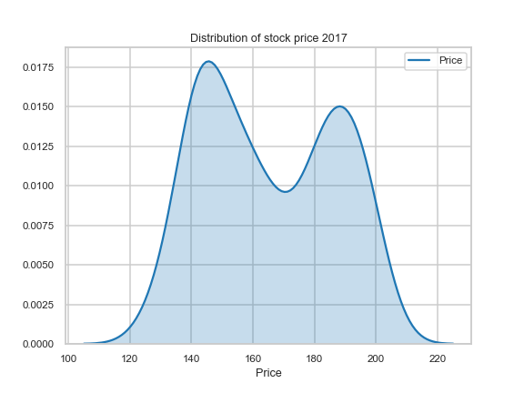
2.1 Distribution of the stock price for Netflix in 2017
We want to get an understanding of the distribution of the Netflix stock for year 2017, therefore we used a probability density function to display these information.
Conclusion:
The most prices ranges fall between 140 and 160.

Slide 7
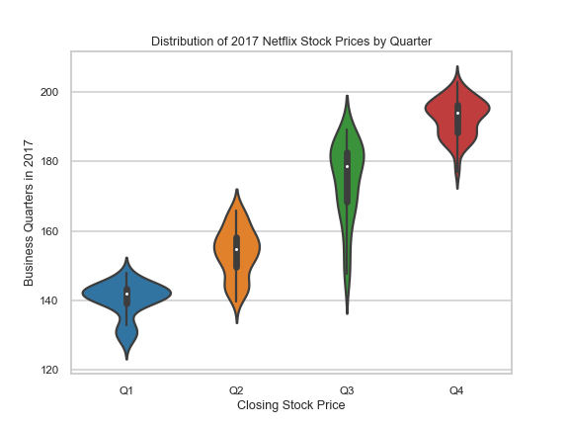
2.1 Netflix stock and revenue for the past four quarters
We want to get an understanding of the distribution of the Netflix quarterly stock prices for year 2017. Specially, we want to see in which quarter stock prices fluctuated the most. We can accomplish tis by using a violin plot with four violins, one for each business quarter.
Conclusion:
The stock value has an ascending rate during entire year, most fluctuated quarter is Q3.

Slide 8
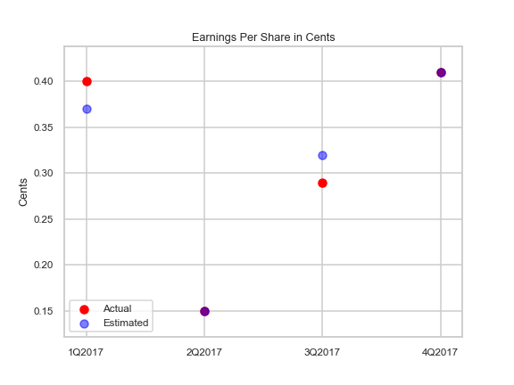
2.1 Estimated versus actual earnings per share for year 2017
We will chart the performance of the earnings per share (EPS)
by graphing the estimate value projected for the Quarter compared to the total earnings for the quarters. We will accomplish this using a scatter plot.
Conclusion:
The purple dots reveals that EPS for actual and estimate earnings have same value.

Slide 9
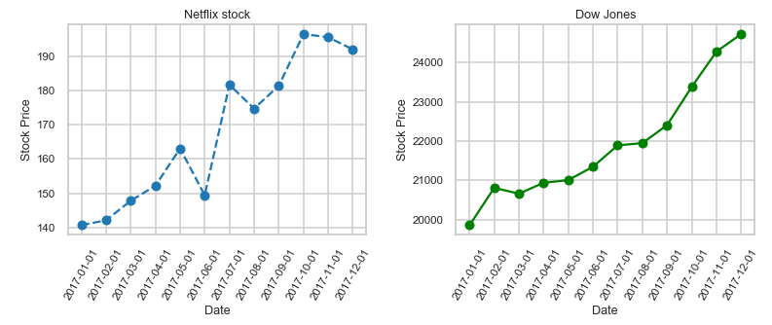
2.1 Netflix stock against the Dow Jones stock in 2017
In this last step, we will compare Netflix stock to the Dow Jones Industrial Average 2017.
We will accomplish this by plotting two line charts side by side in one figure.
Conclusion:
- How did Netflix perform relative to Dow Jones Industrial Average in 2017?
- the stock not in particular the same, referring to peeks and falls but both stocks markets has same ascending shape.
- Which was more volatile?
- Netflix stock has more violent ups and downs, therefore from this point is more volatile than Dow Jones
- How do the prices of the stocks compare?
- The percentage between Min and Max price is almost the same. Netflix stock around 26% and Dow Jones is 25%.

